Slide 1
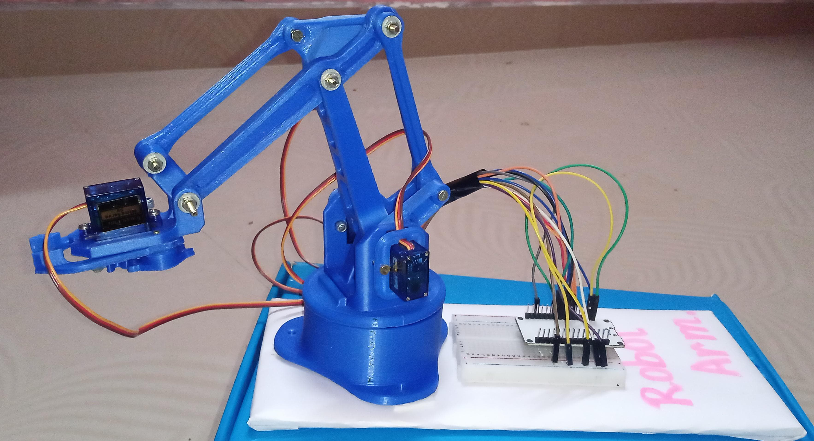
WEB CONTROLLED IOT BASED ROBOTIC ARM USING ESP32

Slide 2
TEAM MEMBERS
K.NANDHANAA III ECE (953721106025)
K.S.SARANYA III ECE (953721106040)
V.POONKODI III ECE (953721106032)

Slide 3
CONTENT:
Abstract
System Architecture
Proposal
Design Setup
Robotic Arm
Servomotor
ESP32
Block Diagram
Website Designing
Literature survey
Disadvantages
Conclusion

Slide 4
ABSTRACT
The aim of this project is to design and develop a web-controlled robotic arm system utilizing the ESP32 microcontroller and IoT technology. The system will allow users to remotely control the movement and functions of the robotic arm through a web interface accessible from any internet-enabled device. The primary objectives include implementing wireless communication between the ESP32 and the web interface, integrating motor control to facilitate precise movement of the robotic arm, and providing real-time feedback to the user. Additionally, the project aims to explore the potential applications of such a system in industrial automation, home automation, and educational settings.

Slide 5
SYSTEM ARCHITECTURE
The system architecture consists of three main components:
ESP32 Microcontroller: Acts as the central processing unit and handles communication between the web interface and the robotic arm.
Servo Motors: Responsible for the movement of the robotic arm's joints.
Web Interface: Provides users with a graphical interface to control the robotic arm remotely via a web browser.

Slide 6
PROPOSAL
Objectives:
Design and implement a web interface for controlling the robotic arm's movements in real-time.
Integrate the ESP32 microcontroller with motor drivers to facilitate precise control of the robotic arm's motors.
Implement wireless communication between the ESP32 and the web interface to enable remote control and monitoring.
Incorporate feedback mechanisms to provide real-time status updates and sensor data to the user via the web interface.
Explore potential applications of the web-controlled robotic arm in industrial automation, home automation, and educational settings.

Slide 7
Methodology:
Hardware Setup: Configure the ESP32 microcontroller with motor drivers and sensors required for the robotic arm's operation.
Software Development: Develop firmware for the ESP32 microcontroller to control motor movements and communicate with the web interface.
Web Interface Design: Create a user-friendly web interface using HTML, CSS, and JavaScript to allow users to control the robotic arm remotely.
Integration and Testing: Integrate the hardware and software components, perform rigorous testing to ensure functionality, reliability, and security.
Documentation and Reporting: Document the design, implementation, and testing processes, including user manuals and technical specifications.

Slide 8
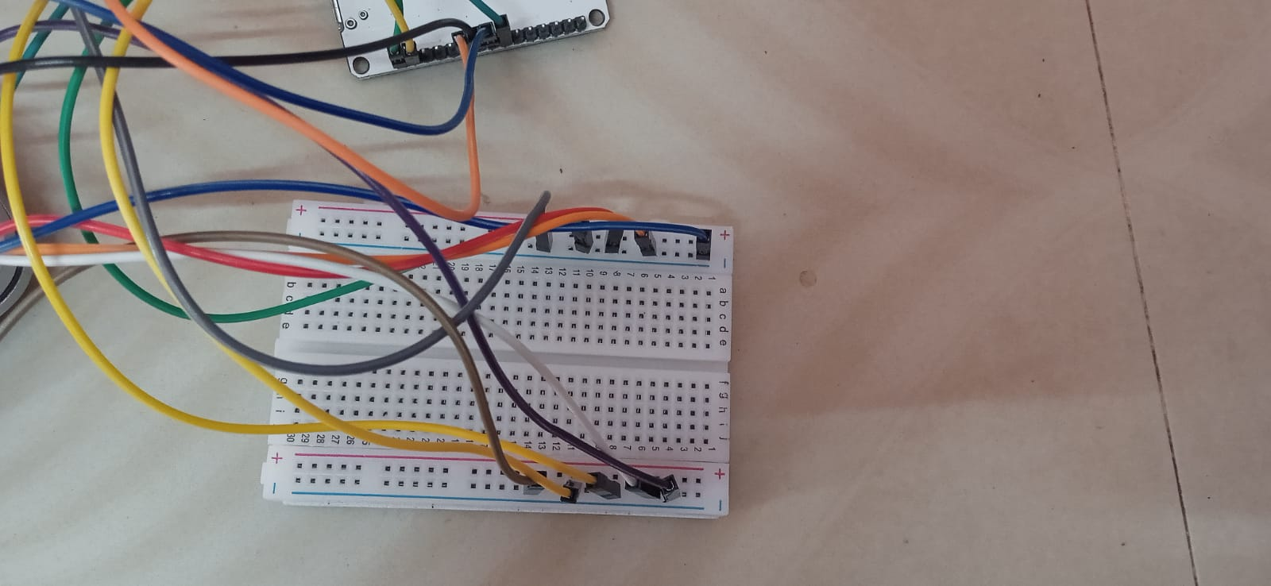
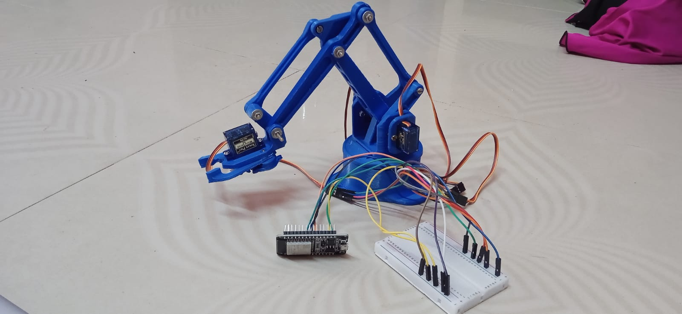
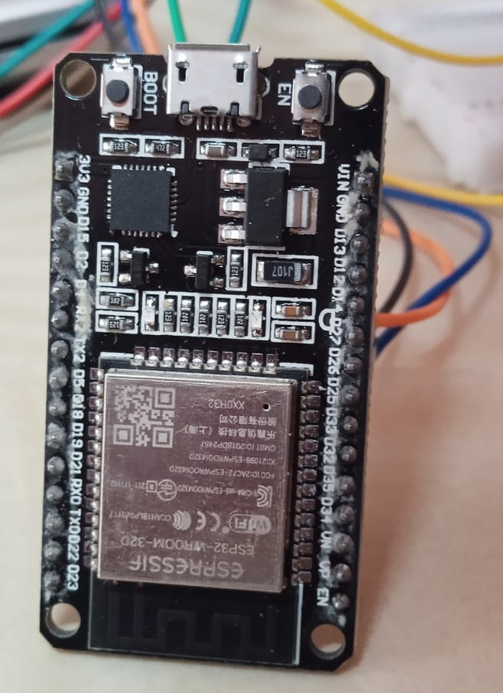
DESIGN SETUP:

Slide 9
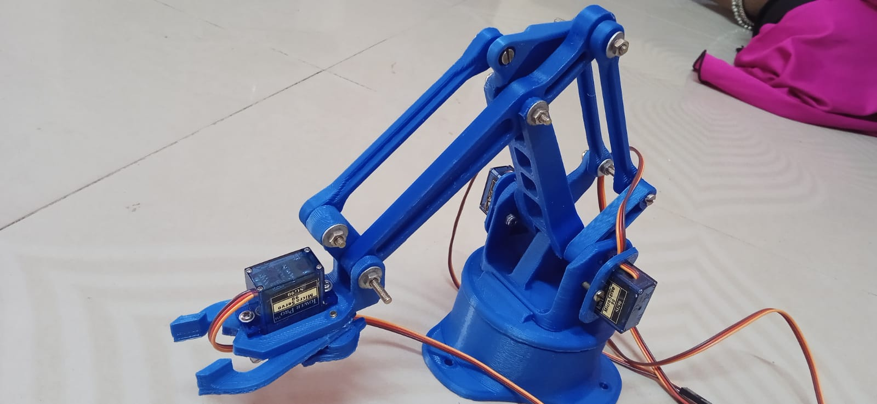
ROBOTIC ARM
A serial robot arm can be described as a chain of links that are moved by joints which are actuated by motors. An end-effector, also called a robot hand, can be attached to the end of the chain. As other robotic mechanisms, robot arms are typically classified in terms of the number of degrees of freedom.
A robotic arm is a device constructed of linkages connected by appropriate joints so that it may move in space and with the degrees of freedom needed for the task at hand. Frequently, the robotic manipulator may be trained to do specific tasks.

Slide 10
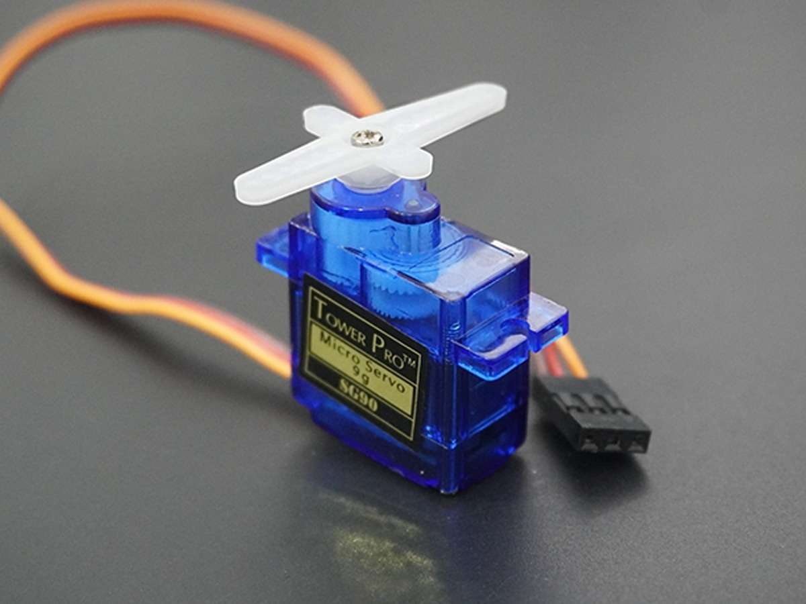
SERVOMOTOR
A servomotor is a closed-loop servomechanism that uses position feedback (either linear or rotational position) to control its motion and final position. The input to its control is a signal (either analog or digital) representing the desired position of the output shaft.
Servo motors or “servos”, as they are known, are electronic devices and rotary or linear actuators that rotate and push parts of a machine with precision. Servos are mainly used on angular or linear position and for specific velocity, and acceleration.

Slide 11
ESP32
ESP32 is highly-integrated with in-built antenna switches, RF balun, power amplifier, low-noise receive amplifier, filters, and power management modules. ESP32 adds priceless functionality and versatility to your applications with minimal Printed Circuit Board (PCB) requirements. Hybrid Wi-Fi & Bluetooth Chip.
ESP32 is a chip that provides Wi-Fi and (in some models) Bluetooth connectivity for embedded devices – in other words, for IoT devices. While ESP32 is technically just the chip, the modules and development boards that contain this chip are often also referred to as “ESP32” by the manufacturer.

Slide 12
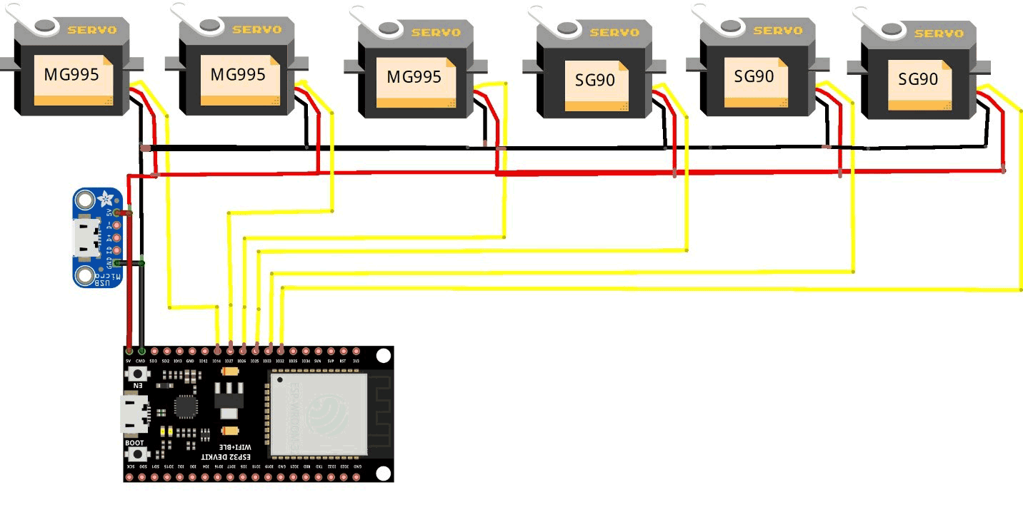
BLOCK DIAGRAM

Slide 13
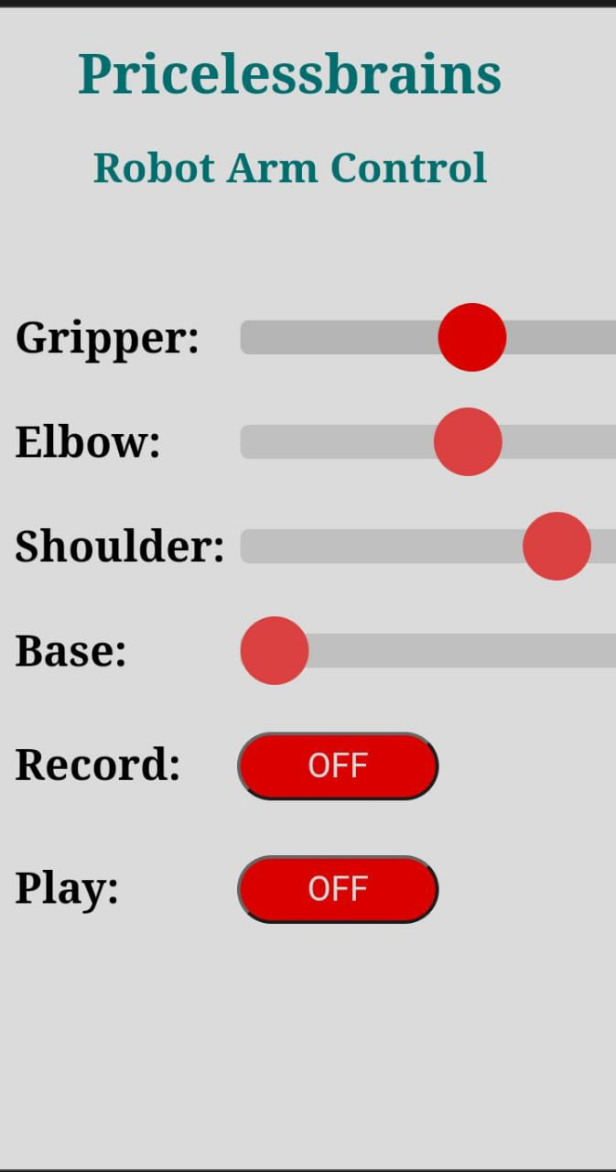
WEBSITE DESIGNING:
In designing your website, it's essential to consider both form and function. Visually, your site should reflect the modern, cutting-edge nature of your project. Clean lines, minimalist design, and high-quality imagery of the robotic arm in action can captivate visitors and highlight its features.

Slide 14
LITERATURE SURVEY:
Remote Accessibility: Users can control the robotic arm from anywhere with internet access through a web interface, enabling remote operation and monitoring.
User-Friendly Interface: The web interface provides an intuitive control platform accessible from various devices, making it easy for users to interact with the robotic arm.
Real-Time Monitoring: Users can receive real-time feedback on the status and performance of the robotic arm, including its position, movements integrated into the system.
Customization and Automation: The project facilitates customization of control parameters and automation of repetitive tasks, improving efficiency and productivity in various applications, such as manufacturing, agriculture, and research.

Slide 15
DISADVANTAGES
Complexity of Implementation: Integrating these components into a cohesive system can be complex and time-consuming.
Compatibility Concerns: Compatibility issues may arise when integrating the ESP32 microcontroller with other hardware components or software platforms.
Power Consumption: IoT devices like the ESP32 may consume significant power, especially when connected to Wi-Fi and performing intensive tasks.

Slide 16
CONCLUSION
In conclusion, the development of the web-controlled IoT-based robotic arm using ESP32 has been a significant endeavor aimed at harnessing the power of IoT technology to enhance robotic control and automation. Through meticulous planning, diligent implementation, and rigorous testing, we have successfully achieved our objectives of creating a versatile, remotely controllable robotic arm system. This project represents a convergence of hardware, software, and web development expertise, resulting in a sophisticated yet user-friendly solution. The integration of the ESP32 microcontroller with motor drivers, sensors, and a web interface has enabled seamless communication and control, empowering users to manipulate the robotic arm's movements with precision and ease from anywhere with internet access.

Slide 17
THANK YOU

